Slide 1

Power Controller

Slide 2
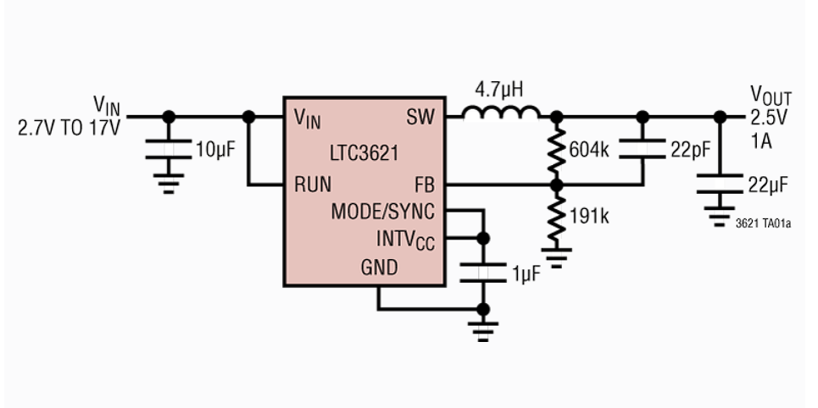
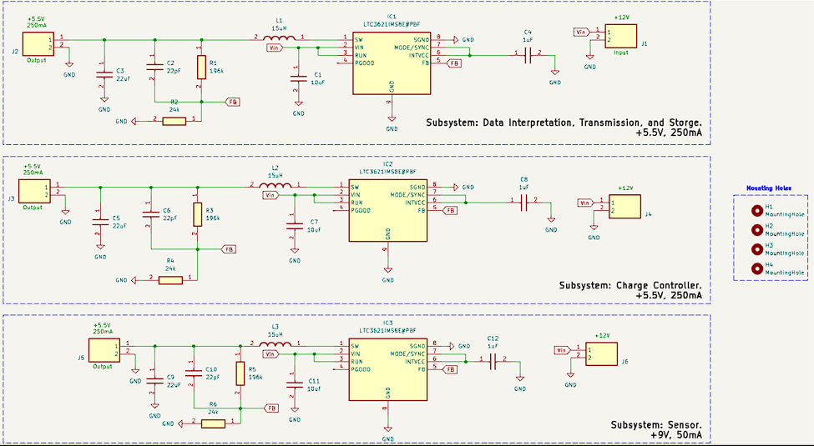
Voltage Regulators
Buck-Boost Converter
Buck Converter
Boost Converter

Slide 3
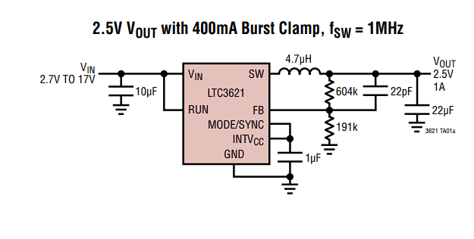
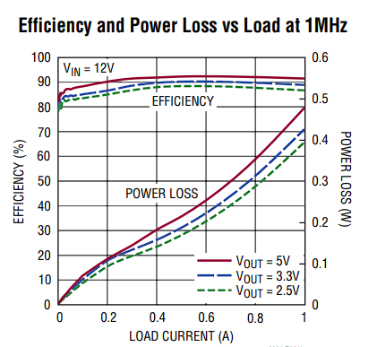
Buck Converter
LTC3621 17V, 1A Synchronous Step-Down Regulator with 3.5μA Quiescent Current
Wide V_{IN} Range: 2.7V to 17V
Wide V_{OUT} Range: 0.6V to V_{IN}
95% Max Efficiency
Constant Frequency (1MHz/2.25MHz)

Slide 4
Sizing and selecting for Buck Converter
No. | Subsystem | Voltage | Current
a | Data interpretation, Transmission, and Storage | 5.5 V | 250 mA
b | Charge Controller | 5.5 V | 250 mA
c | Loop Controller | 9 V | 50 mA

Slide 5
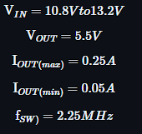
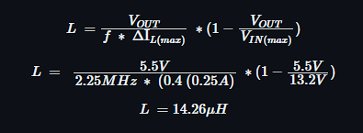
Sizing and selecting for Buck Converter
No. | Subsystem | Voltage | Current
a | Data interpretation, Transmission, and Storage | 5.5 V | 250 mA
b | Charge Controller | 5.5 V | 250 mA
Inductor Selection: For starting point is to choose the ripple current to be %40 of I_out(max). To ensure that the ripple current does not exceed the specified maximum.
Given this, a 14.26µH, we can pick the inductor as 15µH, which would suffice
Notes:
Inductor Selection: For starting point is to choose the ripple current to be %40 of I_out(max). To ensure that the ripple current does not exceed the specified maximum.

Slide 6
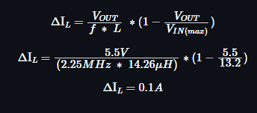
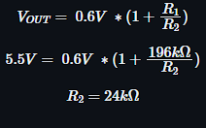
Sizing and selecting for Buck Converter
Ripple Current Selection
Feedback resistors Selection:

Slide 7
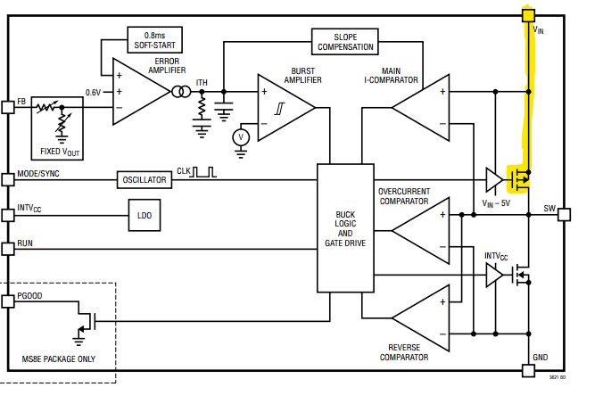
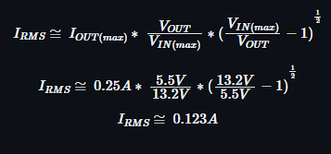

Sizing and selecting for Buck Converter
Input Capacitor Selection = 10µF ceramic capacitor
$I_{RMS}$ Value
Output Capacitor Selection:
a 22µF ceramic capacitor is selected
Notes:
The input capacitance, CIN, is needed to filter the square wave current at the drain of the top power MOSFET. To prevent large voltage transients from occurring, a low Equivalente Series Resistance ESR input capacitor sized for the maximum RMS current should be used. The maximum RMS current is given by

Slide 8
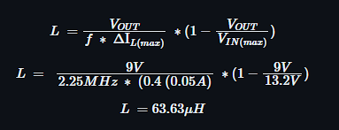
Sizing and selecting for Buck Converter
No. | Subsystem | Voltage | Current
c | Loop Controller | 9 V | 50 mA
Inductor Selection: For starting point is to choose the ripple current to be %40 of I_out(max). To ensure that the ripple current does not exceed the specified maximum.
Given this, a 63,63µH, we can pick the inductor as 68µH, which would suffice

Slide 9
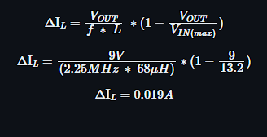
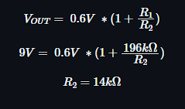
Sizing and selecting for Buck Converter
Ripple Current Selection
Feedback resistors Selection:

Slide 10
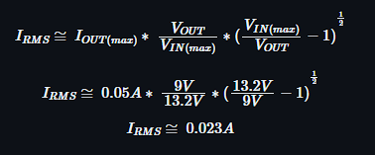
Sizing and selecting for Buck Converter
Input Capacitor Selection = 10µF ceramic capacitor
$I_{RMS}$ Value
Output Capacitor Selection:
a 22µF ceramic capacitor is selected
Notes:
The input capacitance, CIN, is needed to filter the square wave current at the drain of the top power MOSFET. To prevent large voltage transients from occurring, a low Equivalente Series Resistance ESR input capacitor sized for the maximum RMS current should be used. The maximum RMS current is given by

Slide 11
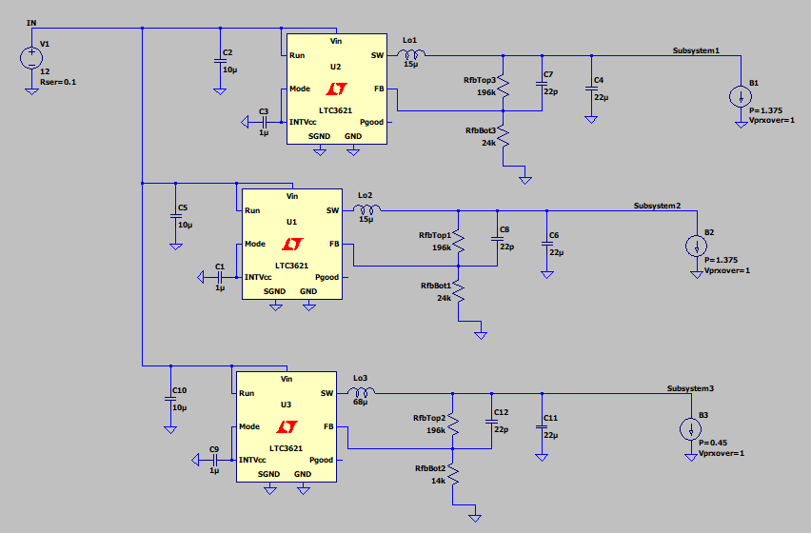
LTSpice Simulation

Slide 12
Kicad

Slide 13
Experiments Result
No. | Subsystem | Expected Voltage | Actual Voltage | Expected current | Actual current
a | Data interpretation, Transmission, and Storage | 5.5 V | 5.34 V | 250 mA | 217.26 mA
b | Charge Controller | 5.5 V | 5.31 | 250 mA | 216.42 mA
c | Loop Controller | 9 V | 9.57 V | 50 mA | 54.49 mA

Slide 14
Reference
Ltc3621-3621-2.Pdf - Analog Devices, www.analog.com/media/en/technical-documentation/data-sheets/ltc3621-3621-2.pdf. Accessed 23 Mar. 2024.
Ti, www.ti.com/lit/an/slva301/slva301.pdf?ts=1694361856373. Accessed 23 Mar. 2024.

